Slide 1
Modern Metrics
2020 2021 2022
Nic Jansma
nic@nicj.net
njansma@akamai.com
@nicj

Slide 2

Modern Metrics
What's new in Web Performance?
Core Web Vitals
Largest Contentful Paint (LCP)
Cumulative Layout Shift (CLS)
First Input Delay (FID)
COVID
(2020)

Slide 3
Modern Metrics
What's new in Web Performance?
Core Web Vitals affecting SEO
COVID
(2021)

Slide 4
Modern Metrics
LESS COVID!
What's new in Web Performance?
A survey of "modern" metrics
Evaluating metrics
Bias
What's the latest and why should you care?
Taking a look yourself!
... 2022?

Slide 5
"Modern" Metrics (2022)
What is a "modern" metric?
BBQ
CWV
OMG
INP
LCP
FID
CLS

Slide 6

REWIND!

Slide 7
"Modern" Metrics (2020)
CWV
FID
LCP
CLS

Slide 8

"Modern" Metrics (2018)
LT
TTFI
FCP
TTI
FMP

Slide 9

"Modern" Metrics (2016)
PLT
SPA
SPDY
CSS
CDN

Slide 10


"Modern" Metrics (2008)
RUM
TCP
XHR
DNS

Slide 11

"Modern" Metrics (2000s)
KB
RTT
PING

Slide 12
BACK TO THE FUTURE!

Slide 13

How to mint a "Modern" Metric
Every year the MMC (Metric Minting Committee) gets together to create a new metric.
Their process:
Step 1: Pick a cool sounding TLA
Step 2: ???
Step 3: Profit!

Slide 14

"Modern" Metrics (2030)
TLA
TLA
TLA

Slide 15

"Modern" Metrics (2022)
Network Focused
DNS, TCP, SSL, RTT, TTFB
Browser Focused
PLT, TBT
Visual
FP, FCP, FMP, LCP, TTVR, SI
User Experience
TTFI, TTI, CLS, FID, INP, Rage Clicks

Slide 16

"Modern" Metrics (2022)
Why do we have so many?
Which of those matter?
Who's in charge of minting these new metrics?
Why should I care?

Slide 17

"Modern" Metrics (2022)
Lean in! Here's the secret
[redacted from slides, only available to live audience]

Slide 18

"Modern" Metrics (2022)
Seriously, lean in!
[redacted from slides, only available to live audience]

Slide 19

"Modern" Metrics (2022)
Measure the things that sound right to you, and see how they compare to the other metrics you care most about
Is that?
Website traffic
Business Metrics
Conversion metrics
Retention metrics
Ads Served

Slide 20
"Modern" Metrics (2022)
What's the latest shiny thing?
The world evolves
Metrics evolve
We should too!
Let's evaluate how metrics behave in the Real World(tm)

Slide 21
Core. Web. Vitals.

Slide 22

Core? Web? Vitals?
There are many ways to interpret and present data that may affect how people react to it.
How can data have bias? In our industry:
RUM vs. Synthetic
Measurement techniques
Dimensions
MPA vs. SPA
Time
Human interpretation

Slide 23

Bias: RUM vs. Synthetic
Synthetic
Stable environment
Access to more + raw data
RUM
Reflection of the real world
Only access to what browsers allow
Beacon time matters

Slide 24

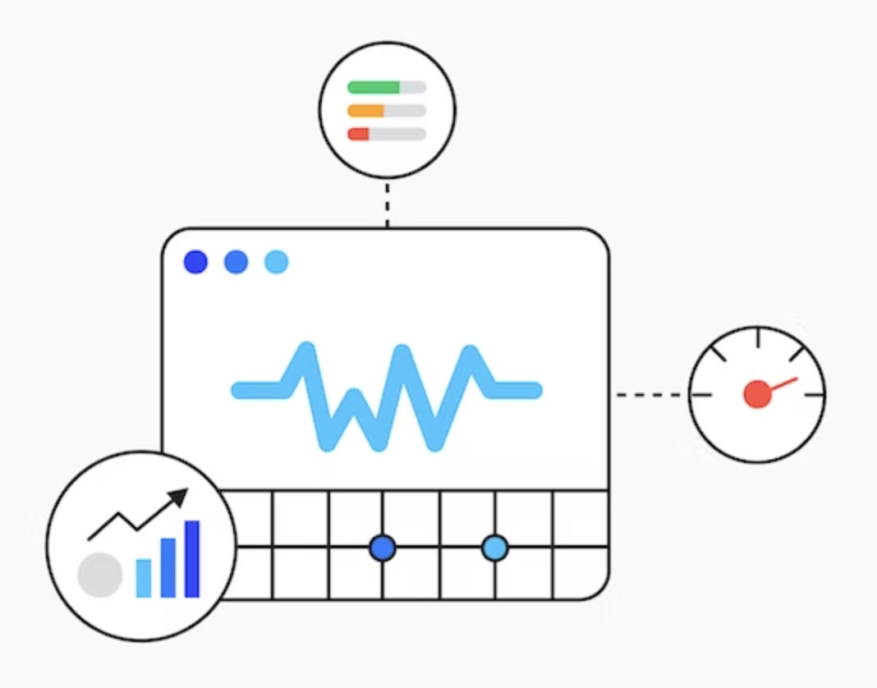


Bias: Measurement Technique
Library
web-vitals.js
boomerang.js
lux.js
perfume.js
ga
Time of the beacon
Load
Unload / Hidden
(multiple)

Slide 25
Bias: Dimensions
Device Type (Desktop vs. Mobile)
Browser
Marketshare
Browser supported APIs
Geolocation
The actual websites being measured
etc

Slide 26
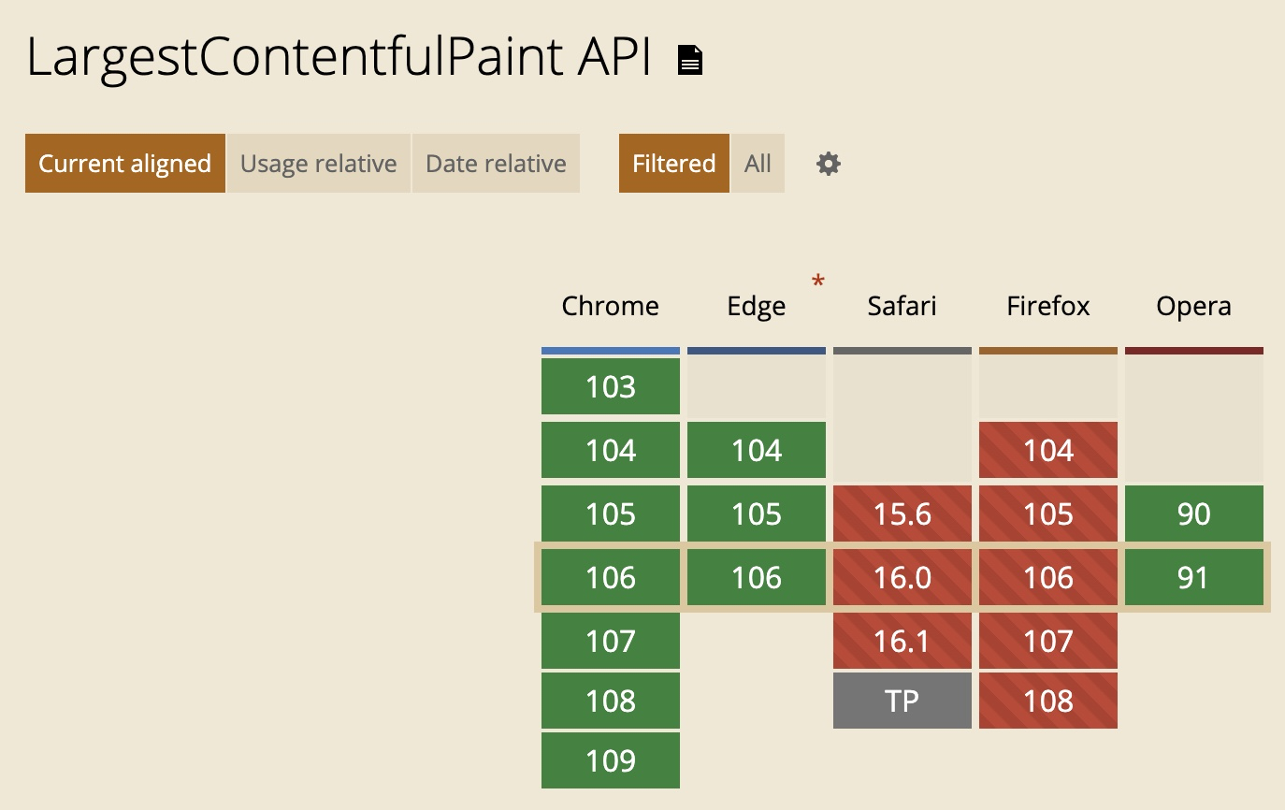
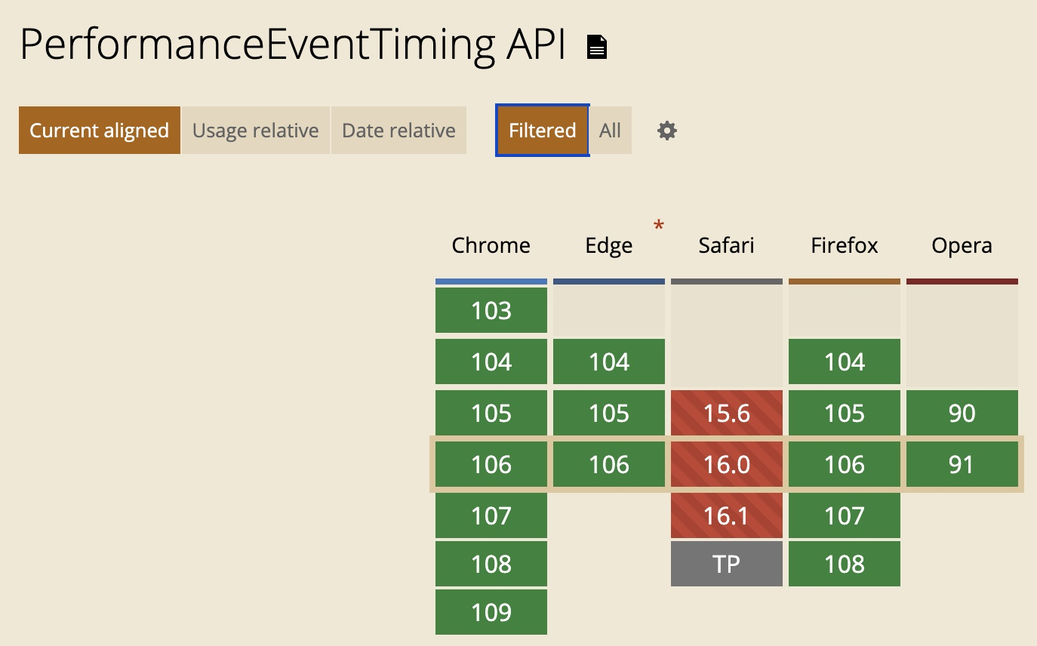
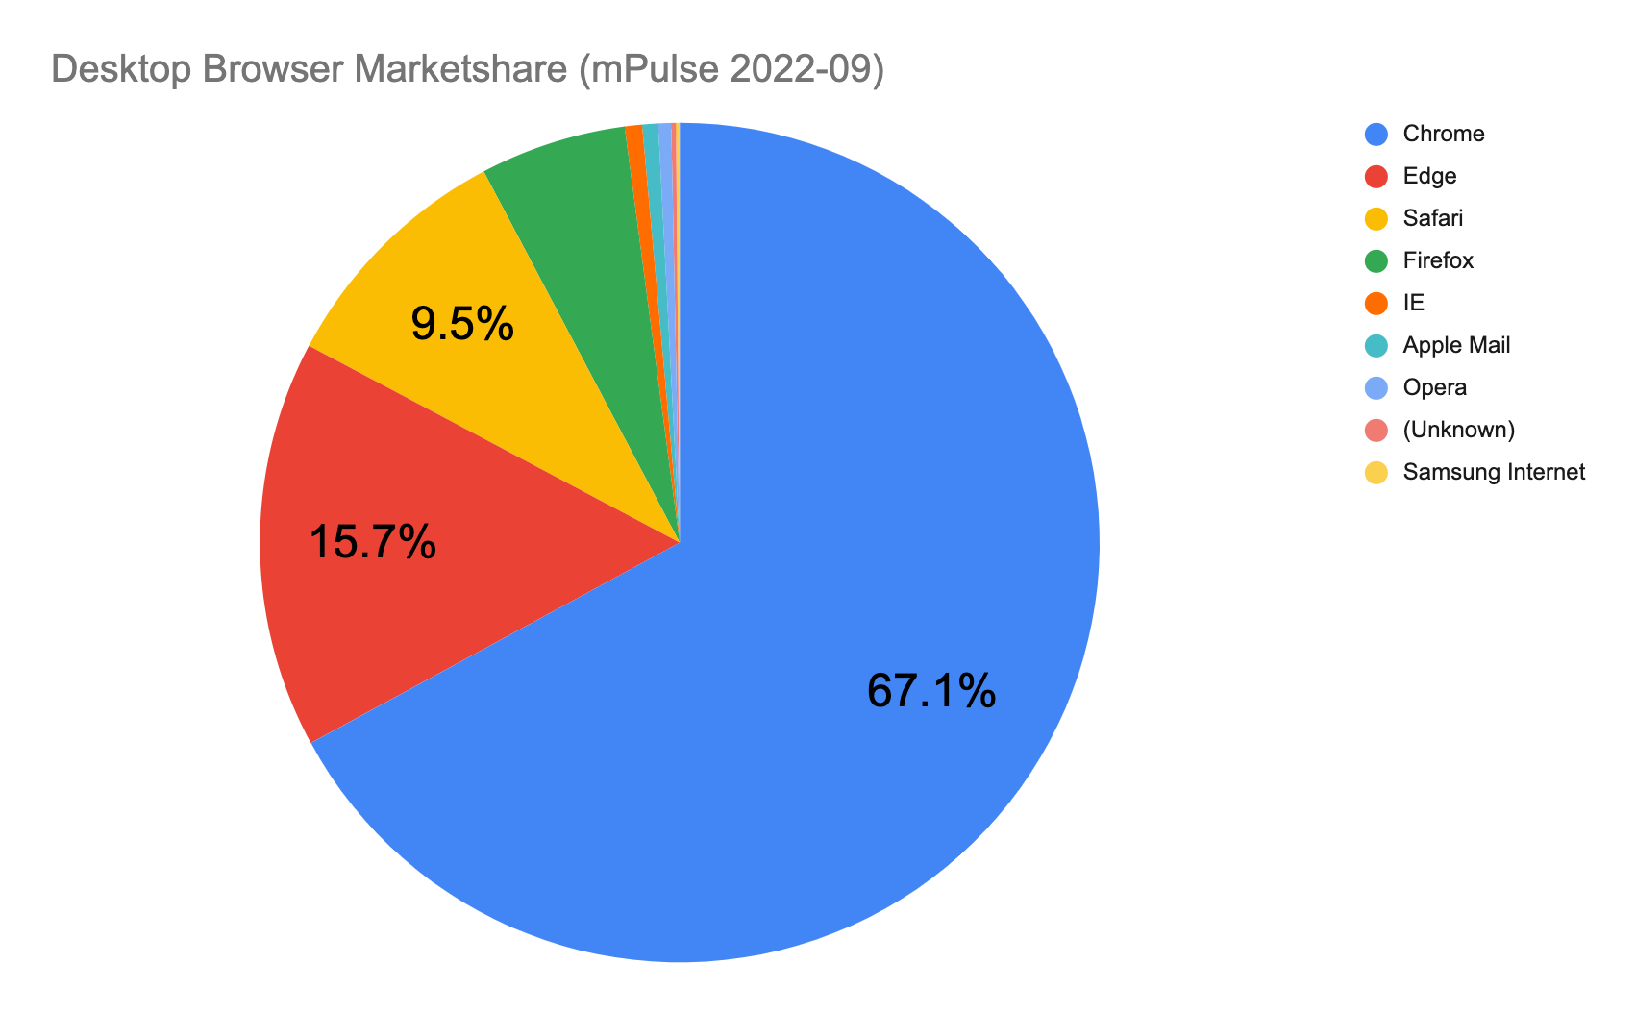
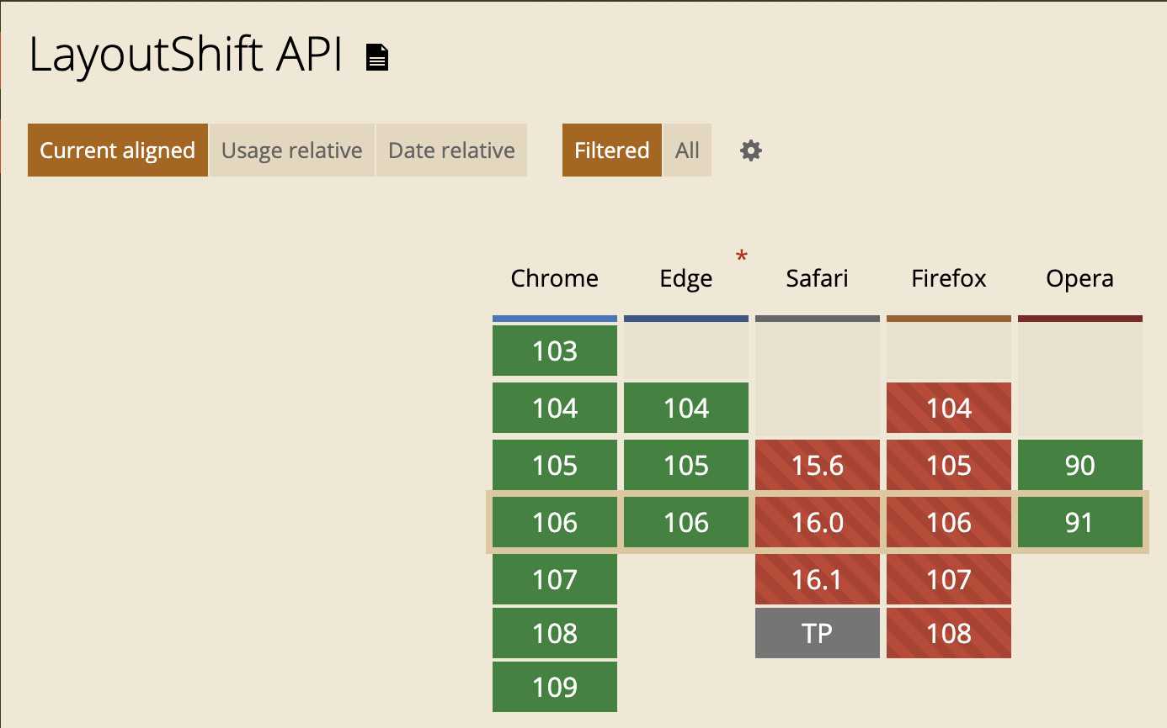
Bias: Dimensions: Browser
Marketshare
Browser supported APIs

Slide 27
Bias: MPA vs. SPA
Synthetic
Often biased towards MPAs (or the Hard navigation of a SPA)
Tools are being updated to support Soft navigations
RUM
Can "split" measurements by soft navigation

Slide 28
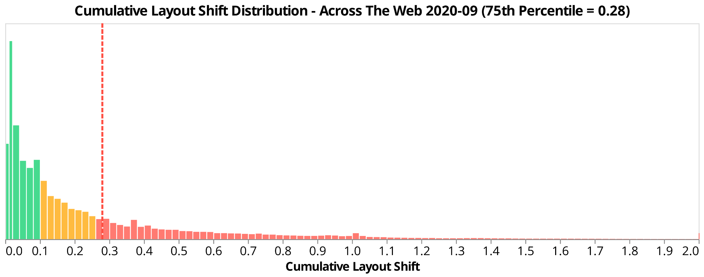
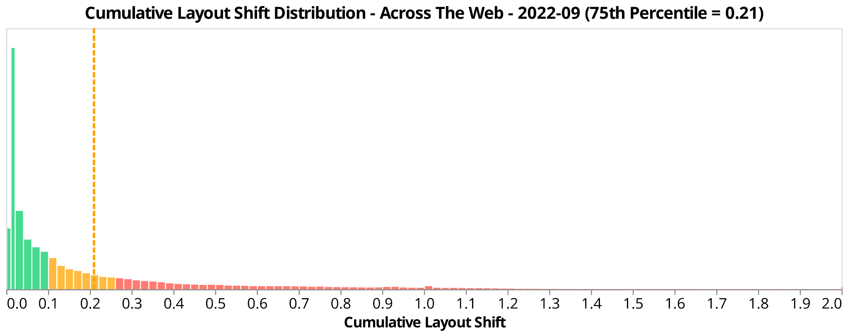
Bias: Time
Time changes all things
Time of Day
Day of Week
+2 years

Slide 29
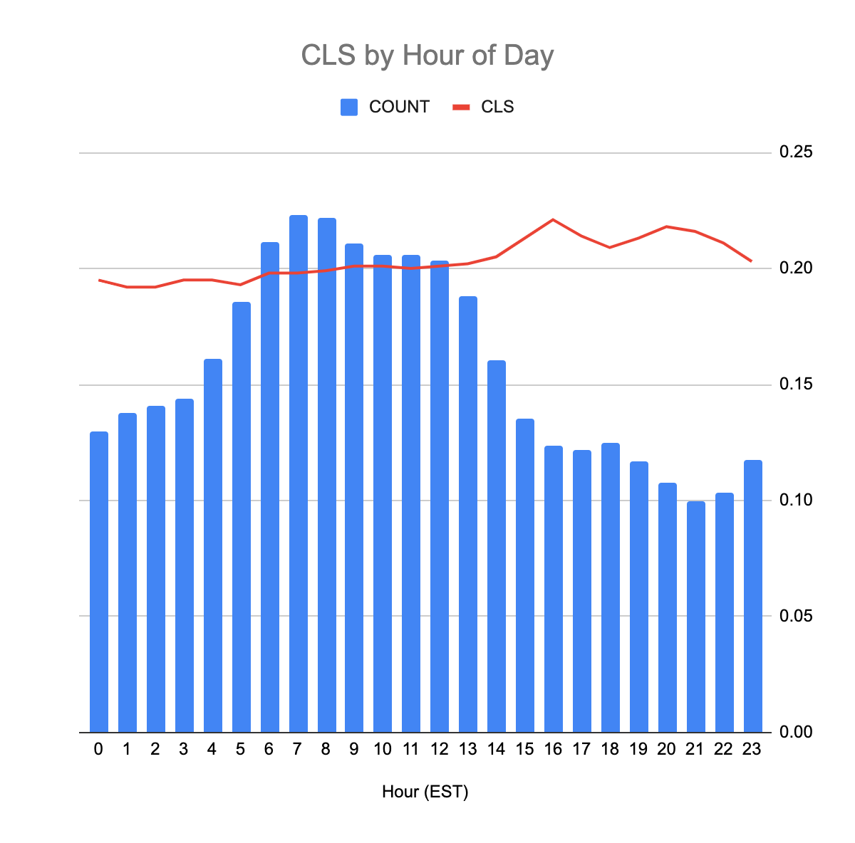
Bias: Time
Time changes all things
Time of Day
Day of Week

Slide 30
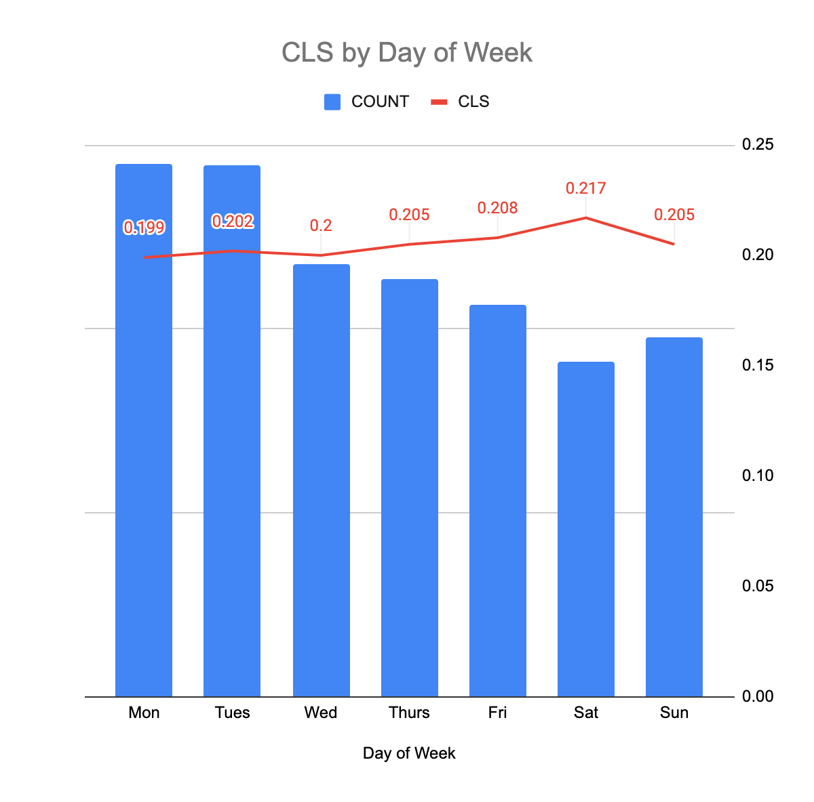
Bias: Time
Time changes all things
Time of Day
Day of Week

Slide 31
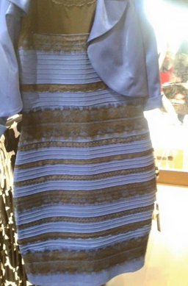
Bias: Human Interpretation
Data is in the eye of the beholder (presenter)
Who is this Nic guy anyway?
BSE, CompSci
!Data Scientist

Slide 32
Core! Web! Vitals!

Slide 33
chart-intensive slides ahead
WARNING

Slide 34
i don't know what I'm saying
WARNING

Slide 35
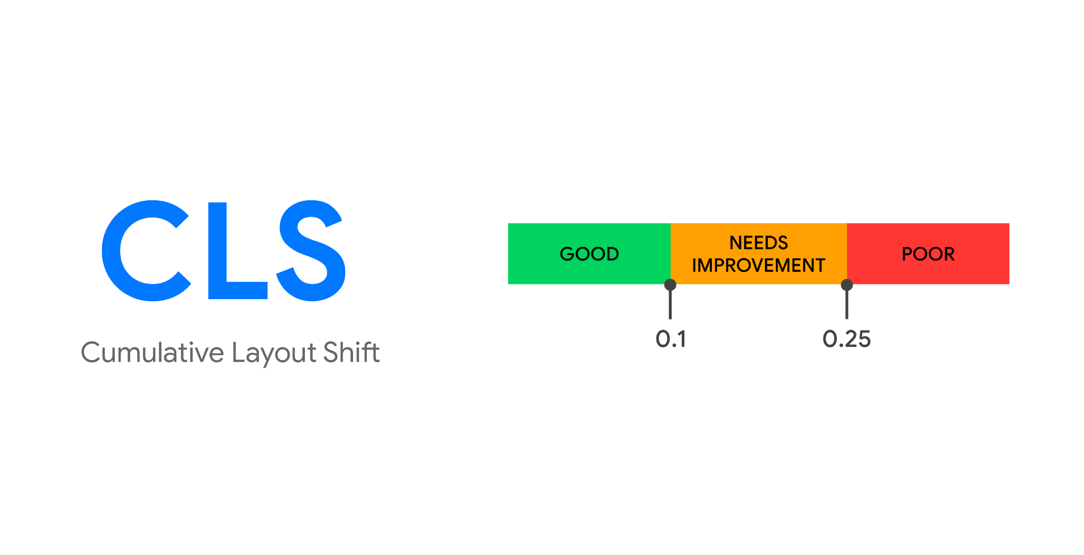

Slide 36
* RUM, mPulse, boomerang.js (MPA+SPA), 2020-09 1w, all browsers that support CLS, 0.02 bucket, n = ~2b, n,nnn sites, Nic

Slide 37
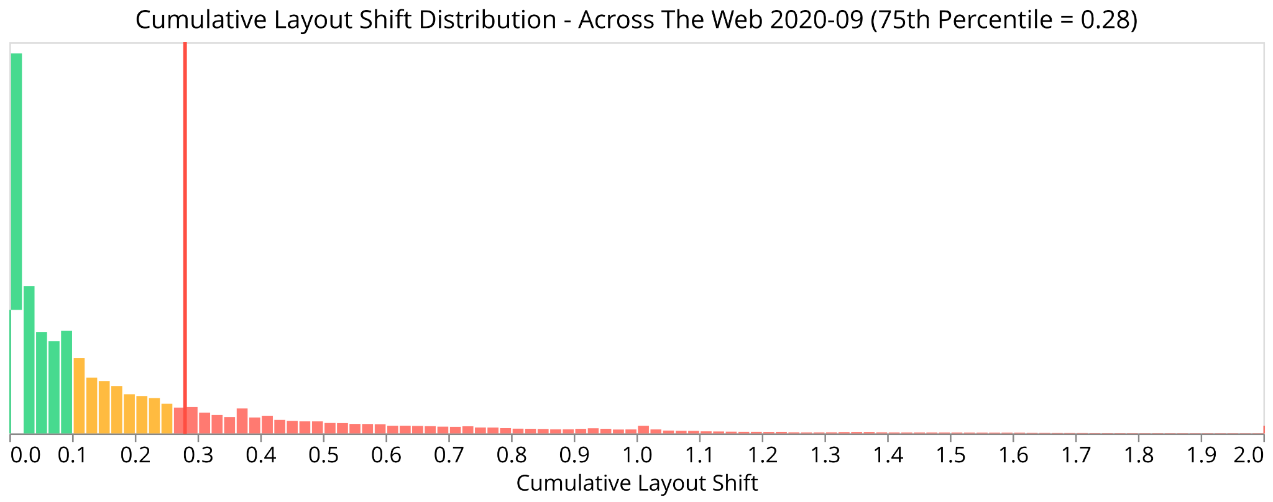
distribution? histogram? what now?
* RUM, mPulse, boomerang.js (MPA+SPA), 2020-09 1w, all browsers that support CLS, 0.02 bucket, n = ~2b, n,nnn sites, Nic

Slide 38
x axis = bucket (0.02 CLS wide)
* RUM, mPulse, boomerang.js (MPA+SPA), 2020-09 1w, all browsers that support CLS, 0.02 bucket, n = ~2b, n,nnn sites, Nic

Slide 39
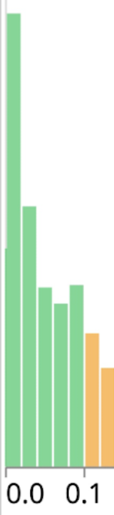
y axis = frequency (how many)
* RUM, mPulse, boomerang.js (MPA+SPA), 2020-09 1w, all browsers that support CLS, 0.02 bucket, n = ~2b, n,nnn sites, Nic

Slide 40
vertical line = 75th percentile
* RUM, mPulse, boomerang.js (MPA+SPA), 2020-09 1w, all browsers that support CLS, 0.02 bucket, n = ~2b, n,nnn sites, Nic

Slide 41
the fine print:
RUM
mPulse
boomerang.js (MPA+SPA+Soft) (@load)
2020-09 (1 week)
all browsers that support CLS
bucket size = 0.02
n = ~25b
# of sampled sites = n,nnn
Nic
* RUM, mPulse, boomerang.js (MPA+SPA), 2020-09 1w, all browsers that support CLS, 0.02 bucket, n = ~2b, n,nnn sites, Nic

Slide 42
more details @
https://nicj.net/cumulative-layout-shift-in-the-real-world/
* RUM, mPulse, boomerang.js (MPA+SPA), 2020-09 1w, all browsers that support CLS, 0.02 bucket, n = ~2b, n,nnn sites, Nic

Slide 43
* RUM, mPulse, boomerang.js (MPA+SPA), 2020-09 1w, all browsers that support CLS, 0.02 bucket, n = ~2b, n,nnn sites, Nic

Slide 44
* RUM, mPulse, boomerang.js (MPA+SPA), 2022-09 1w, all browsers that support CLS, 0.02 bucket, n = ~2b, n,nnn sites, Nic

Slide 45
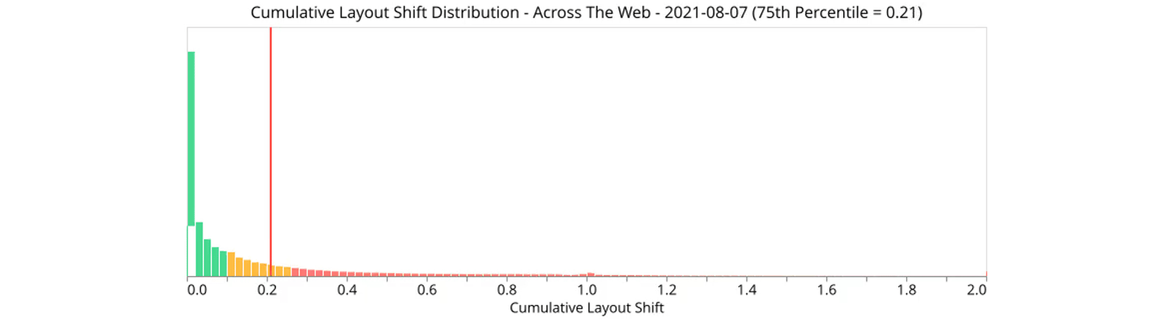

Slide 46
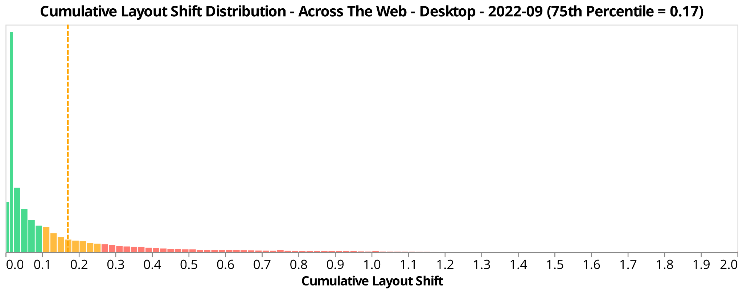
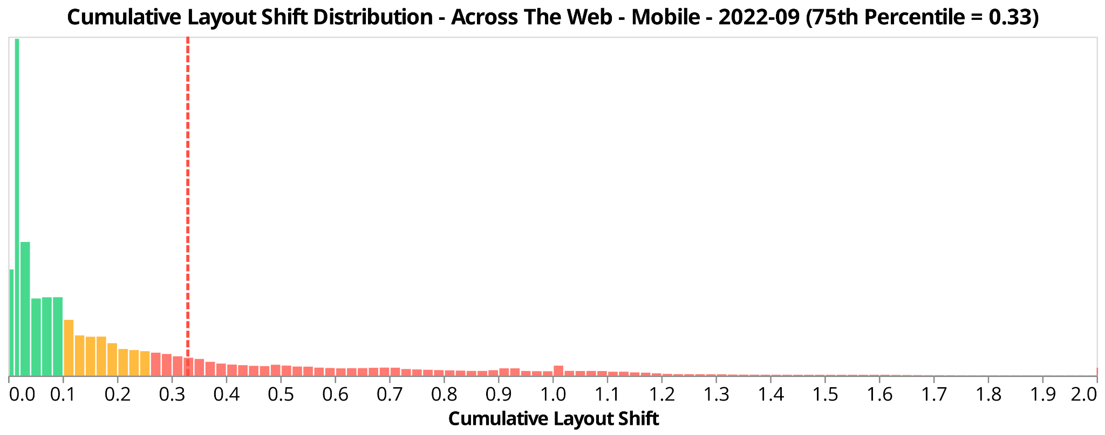

Slide 47
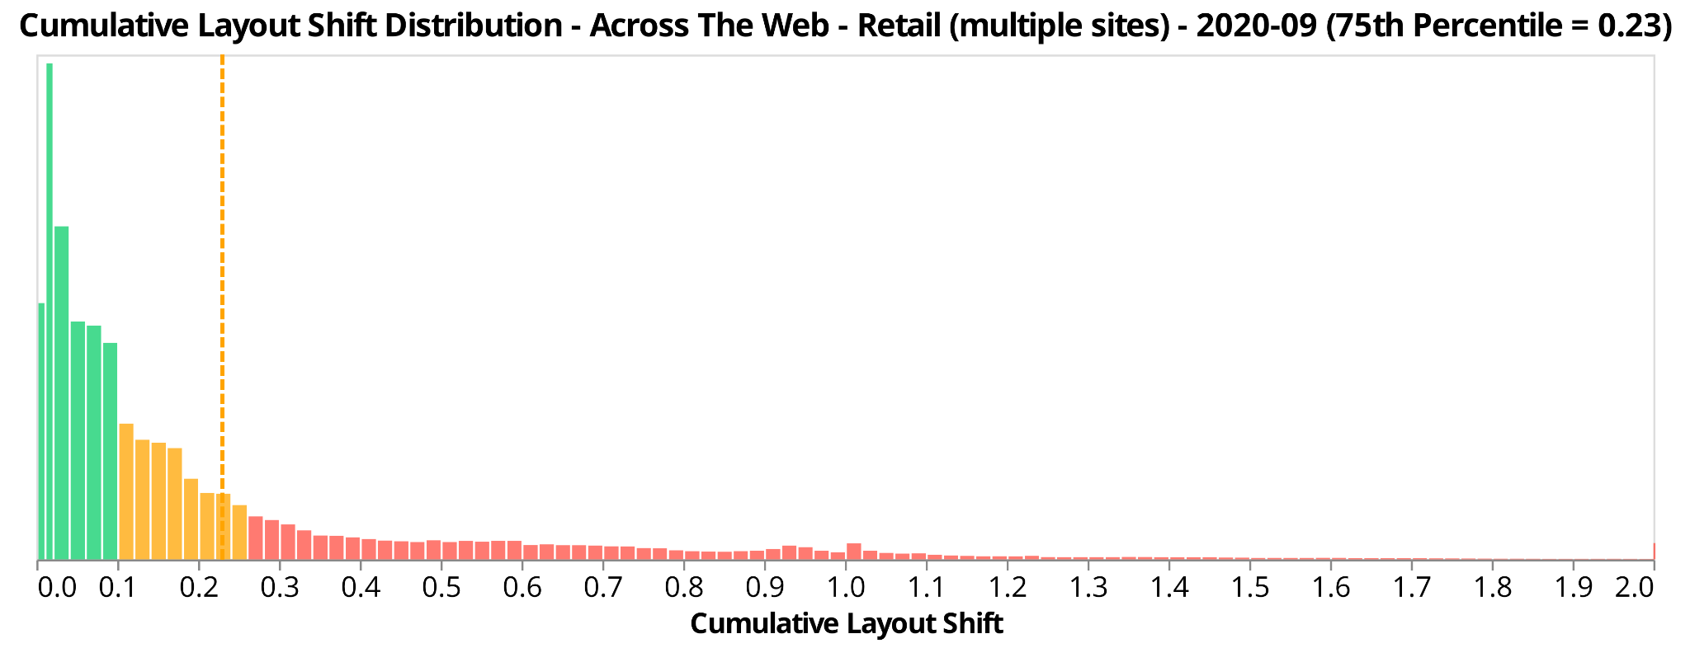
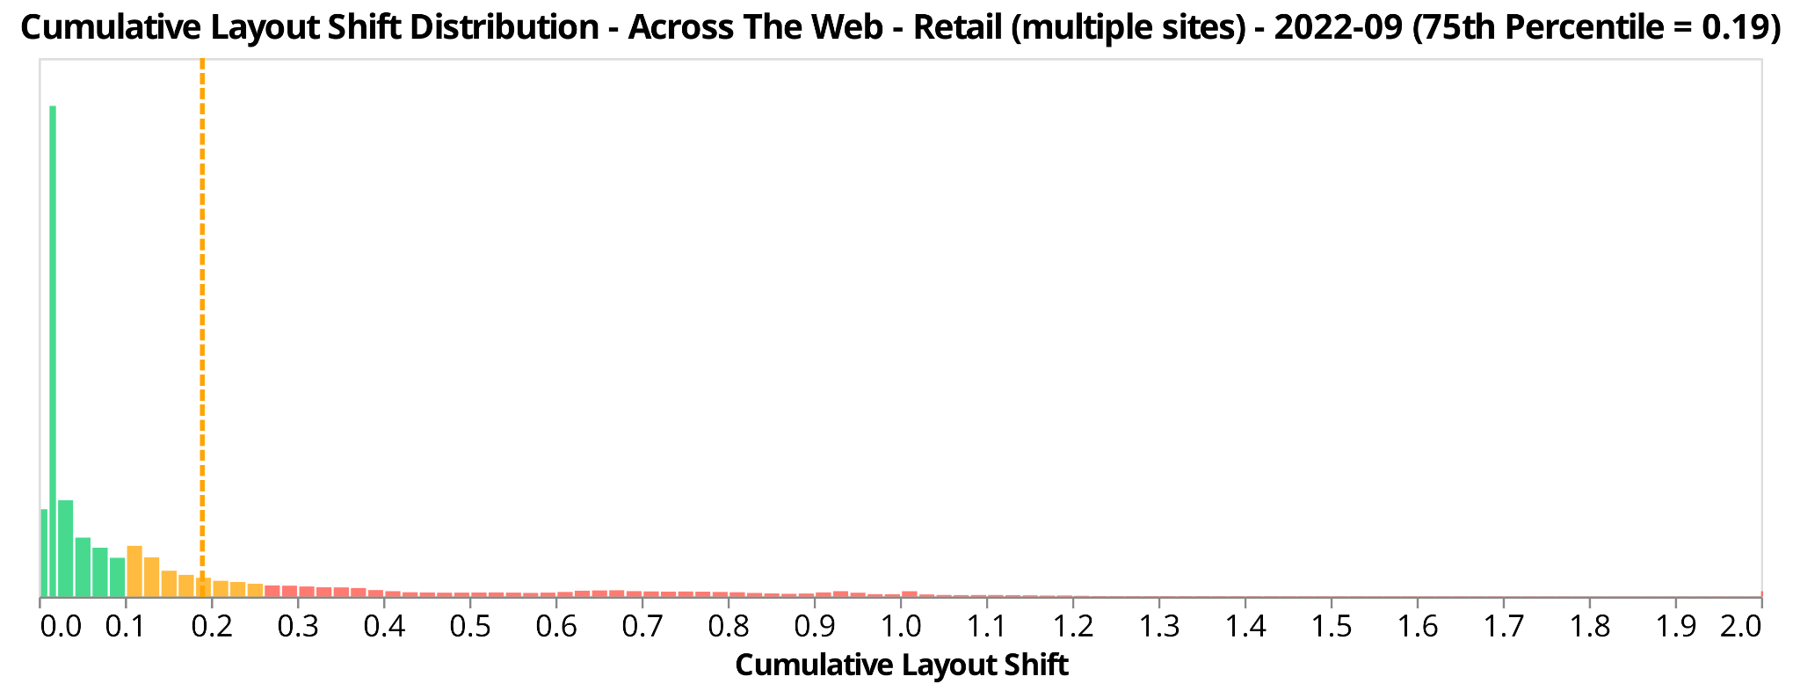
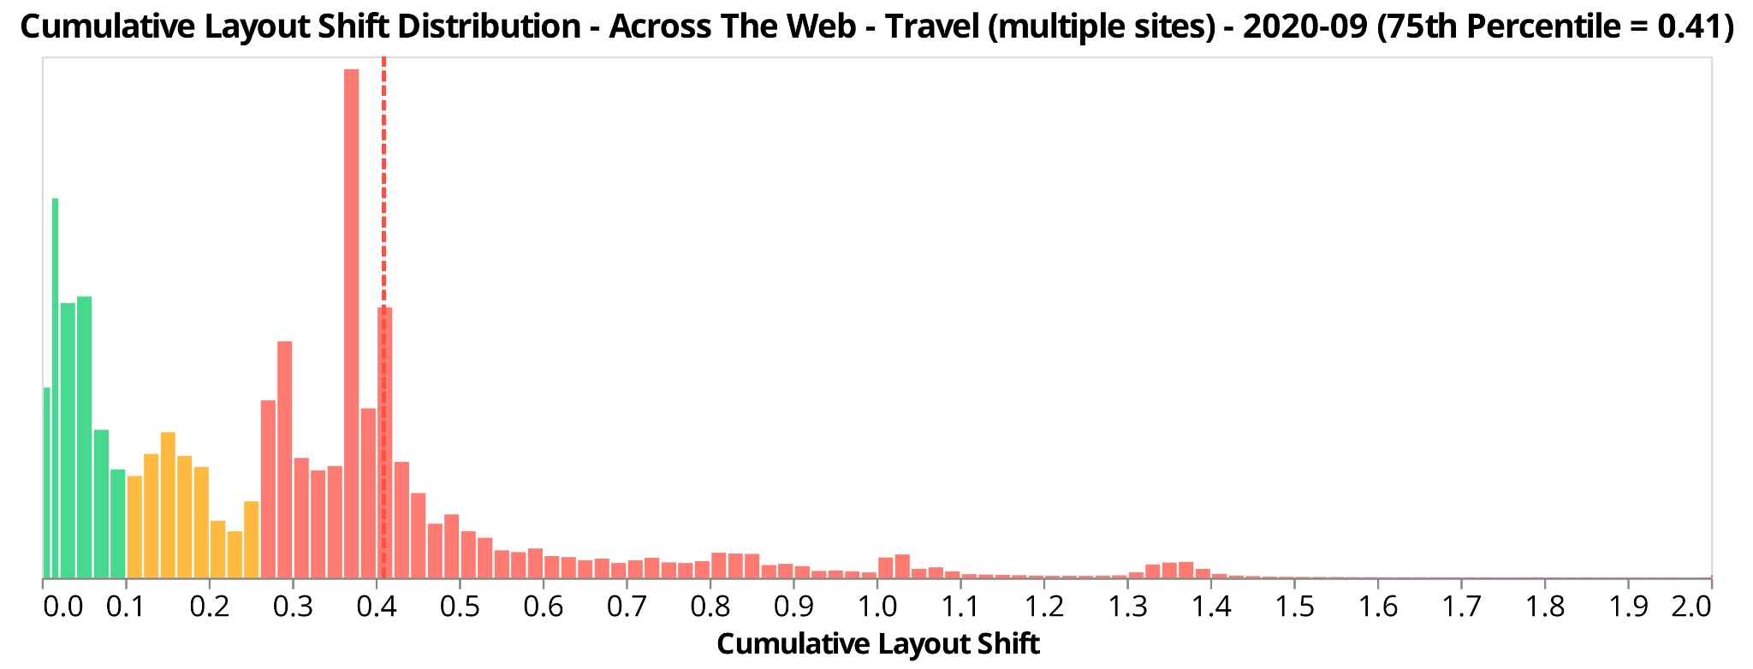
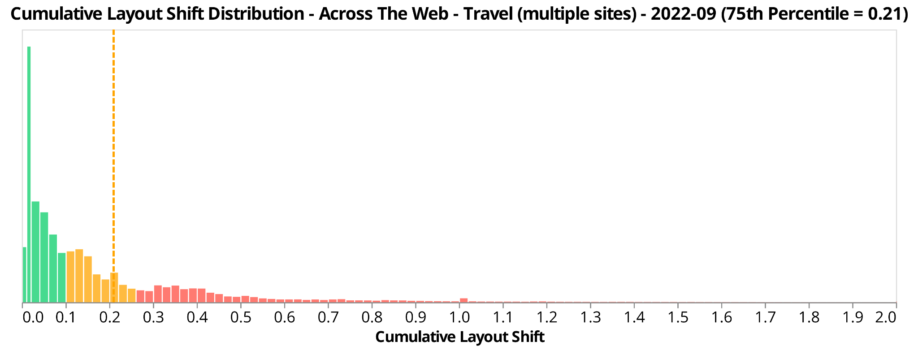
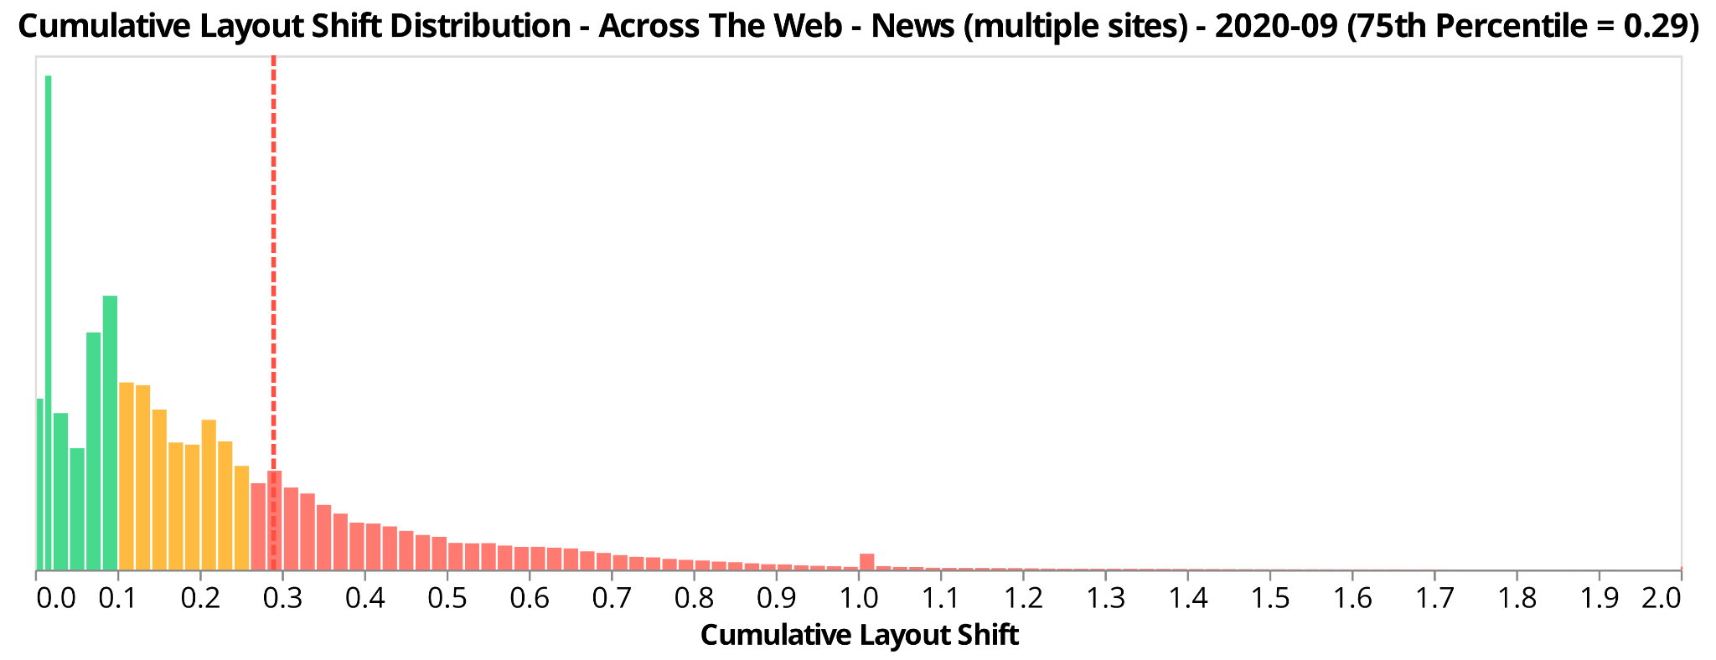
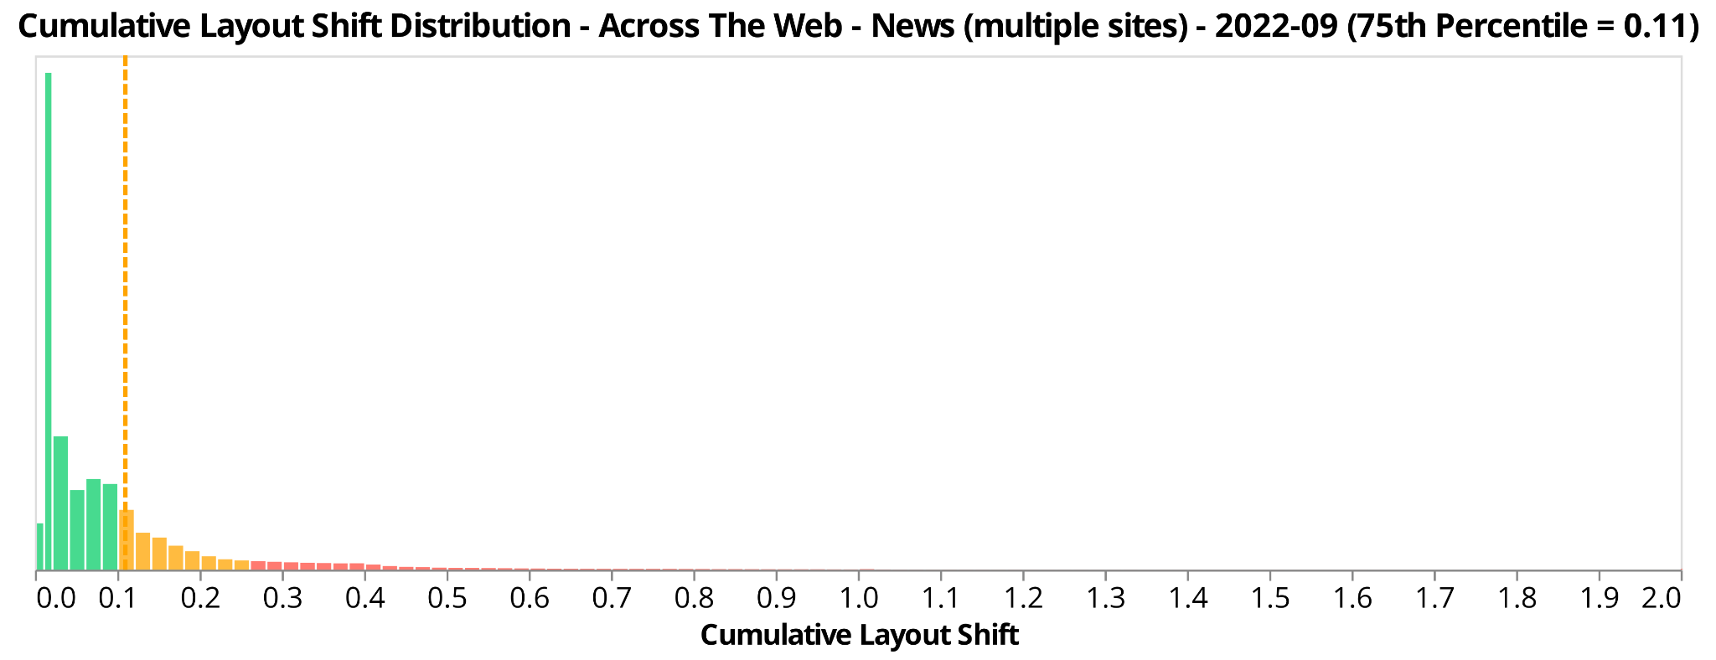
2020-09
2022-09
retail
travel
news

Slide 48
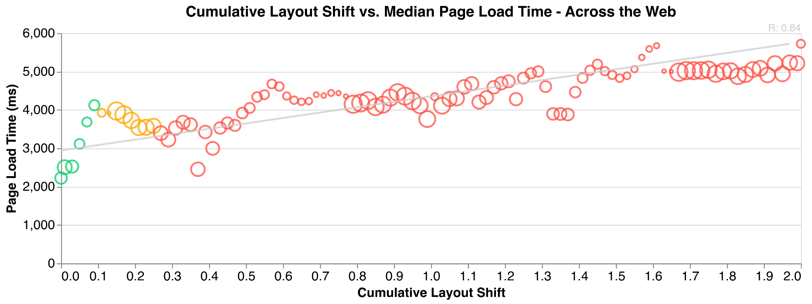

Slide 49
correlation chart?

Slide 50
x = CWV

Slide 51
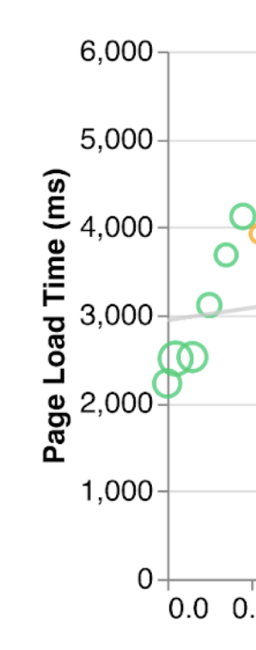
y = timer or business metric

Slide 52
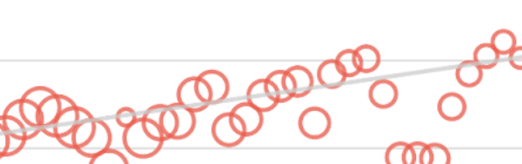
circle size = frequency

Slide 53
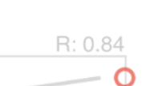
R correlation 1.0 = 1:1 correlation
0 = no correlation
-1.0 = 1:1 negative correlation

Slide 55
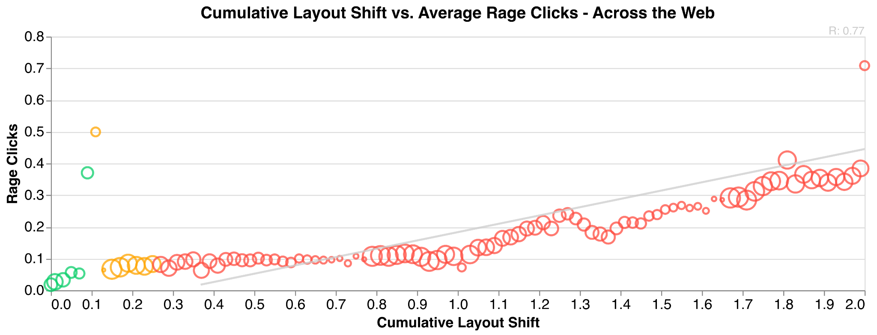

Slide 56
CLS - Data from individual websites
* unrandomly selected by Nic to make a point

Slide 57
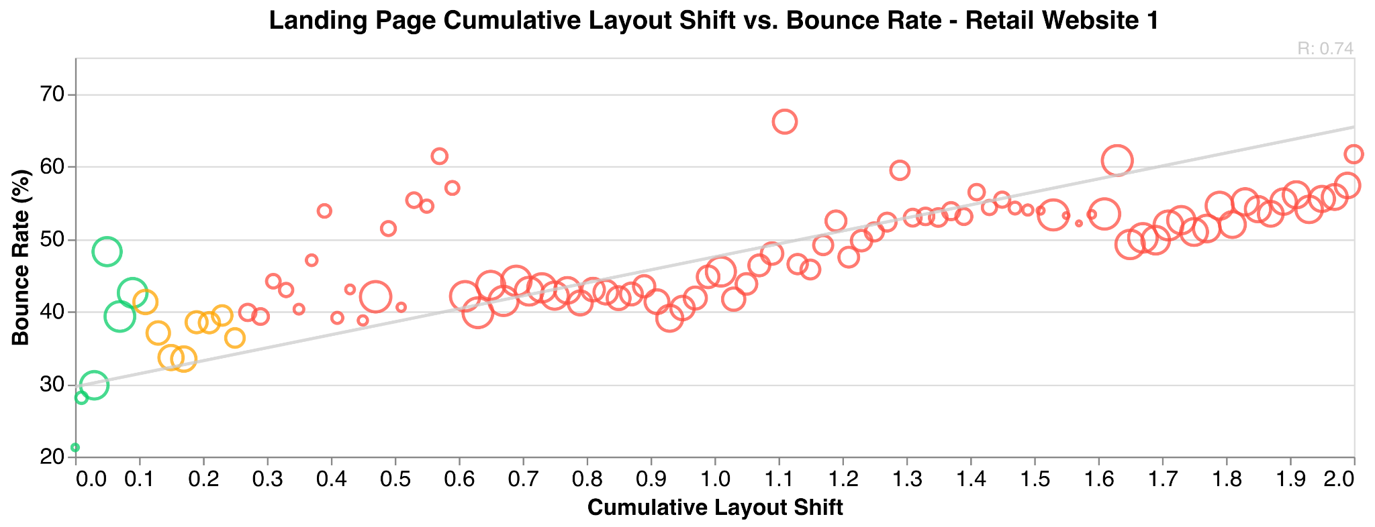

Slide 58
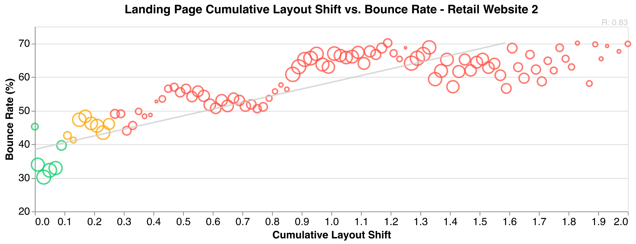

Slide 59
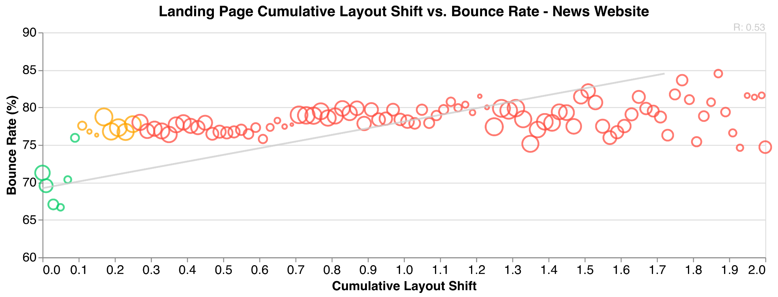

Slide 60
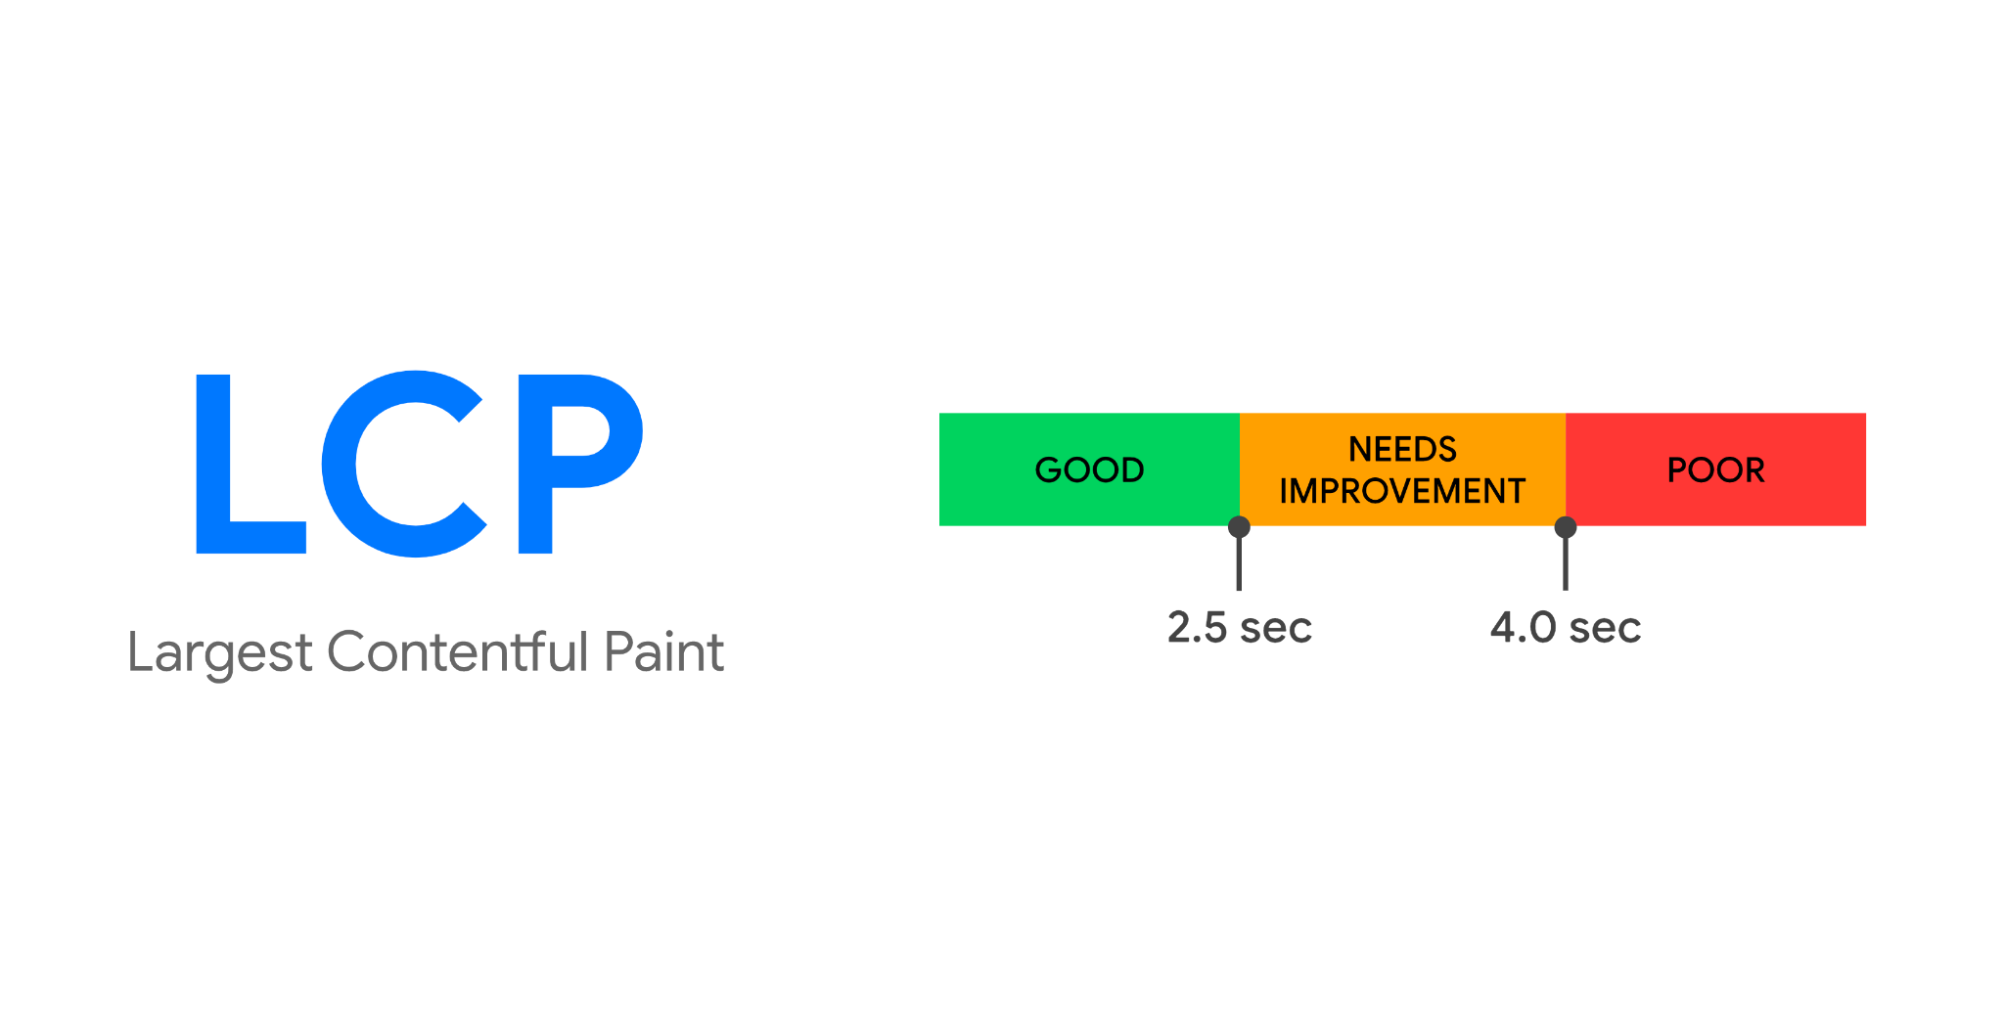

Slide 61
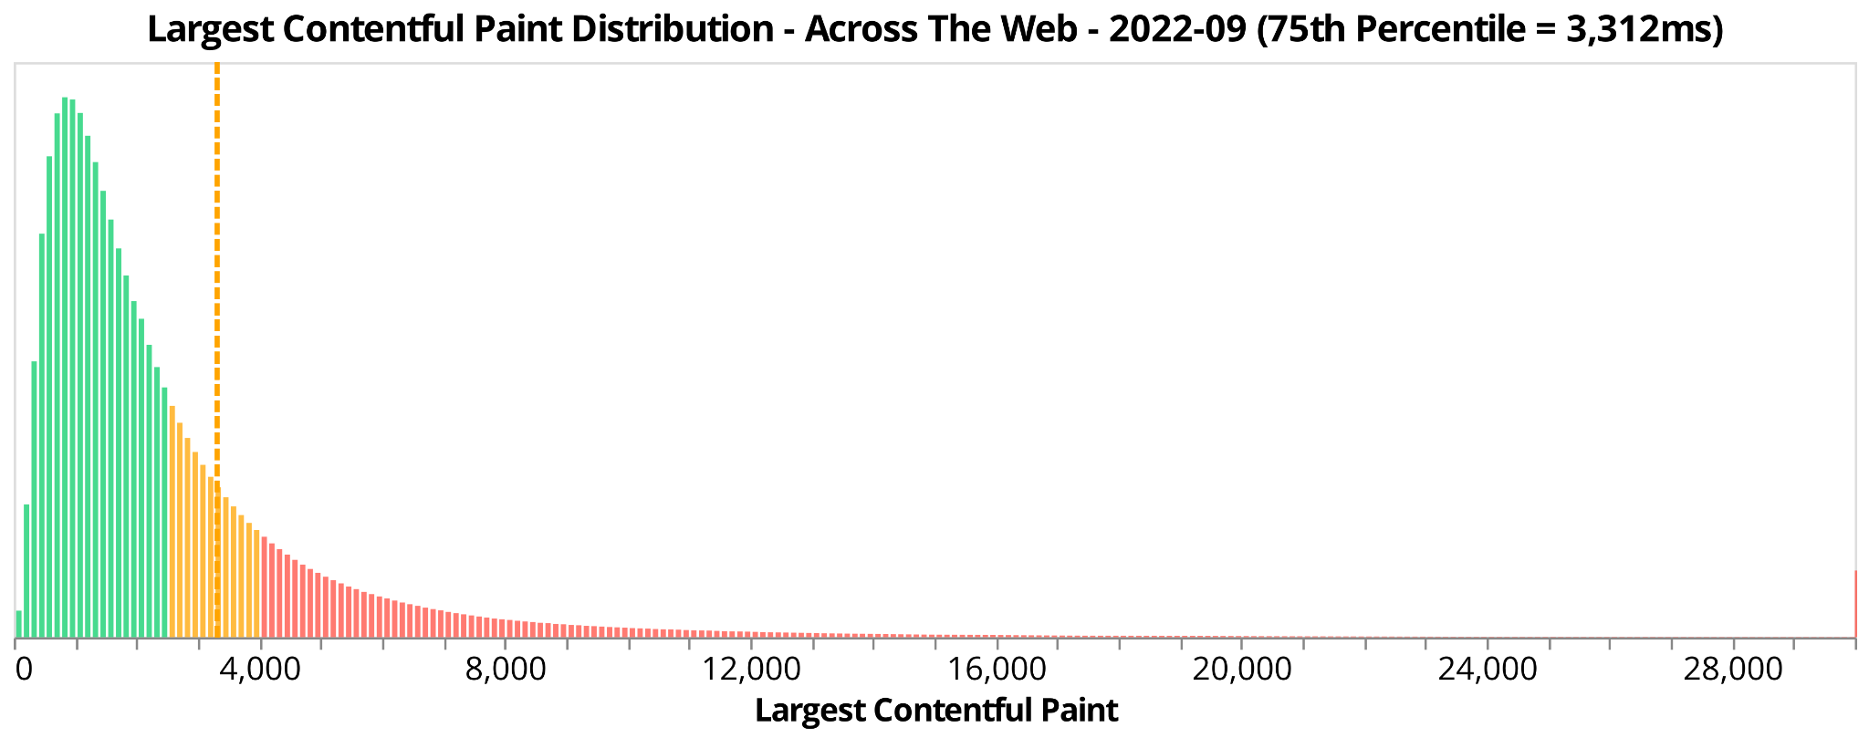

Slide 62
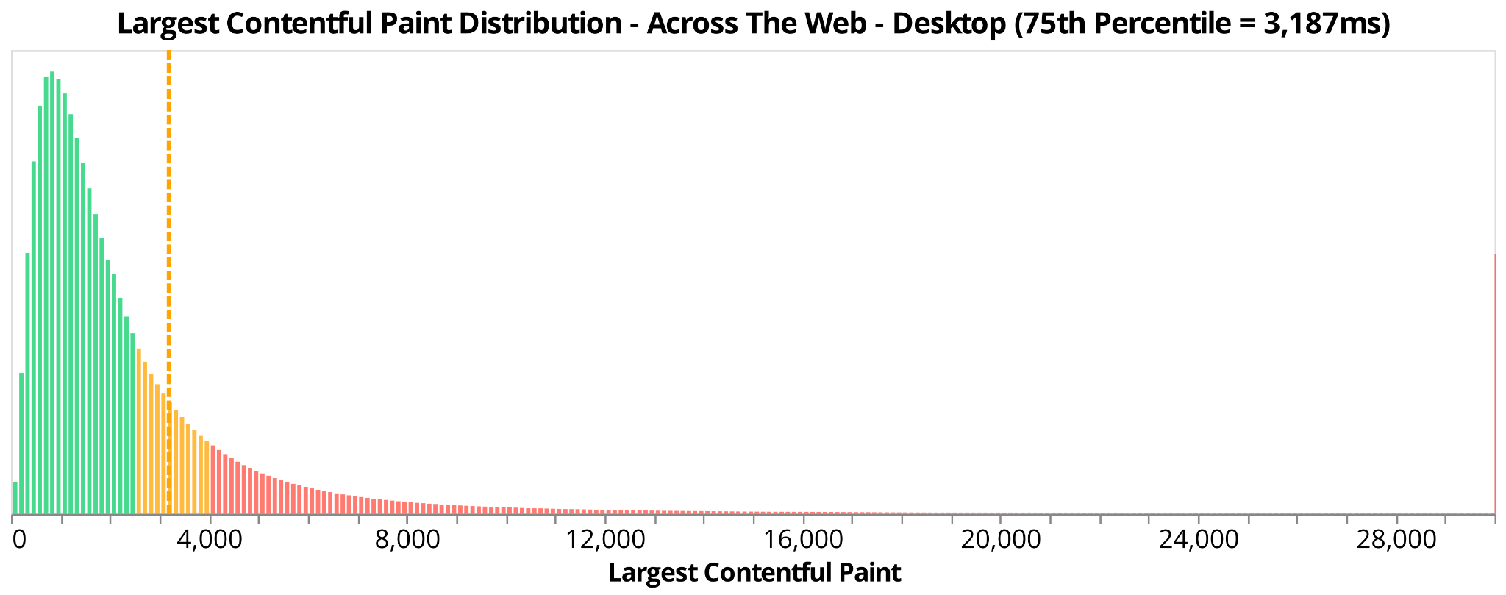
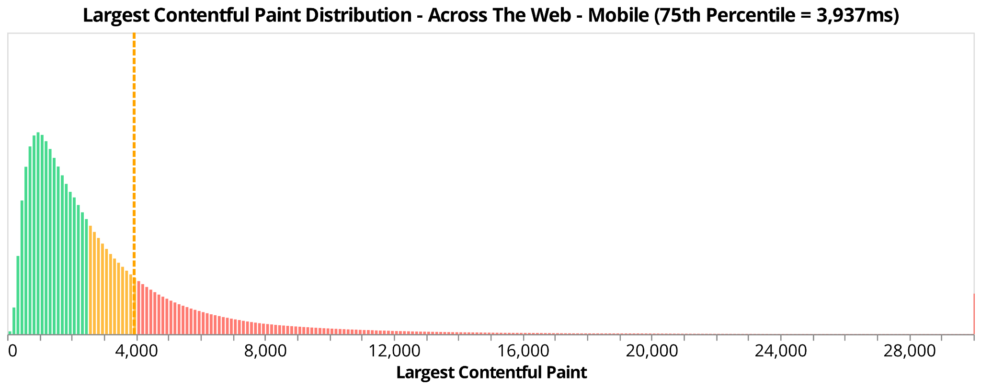

Slide 63

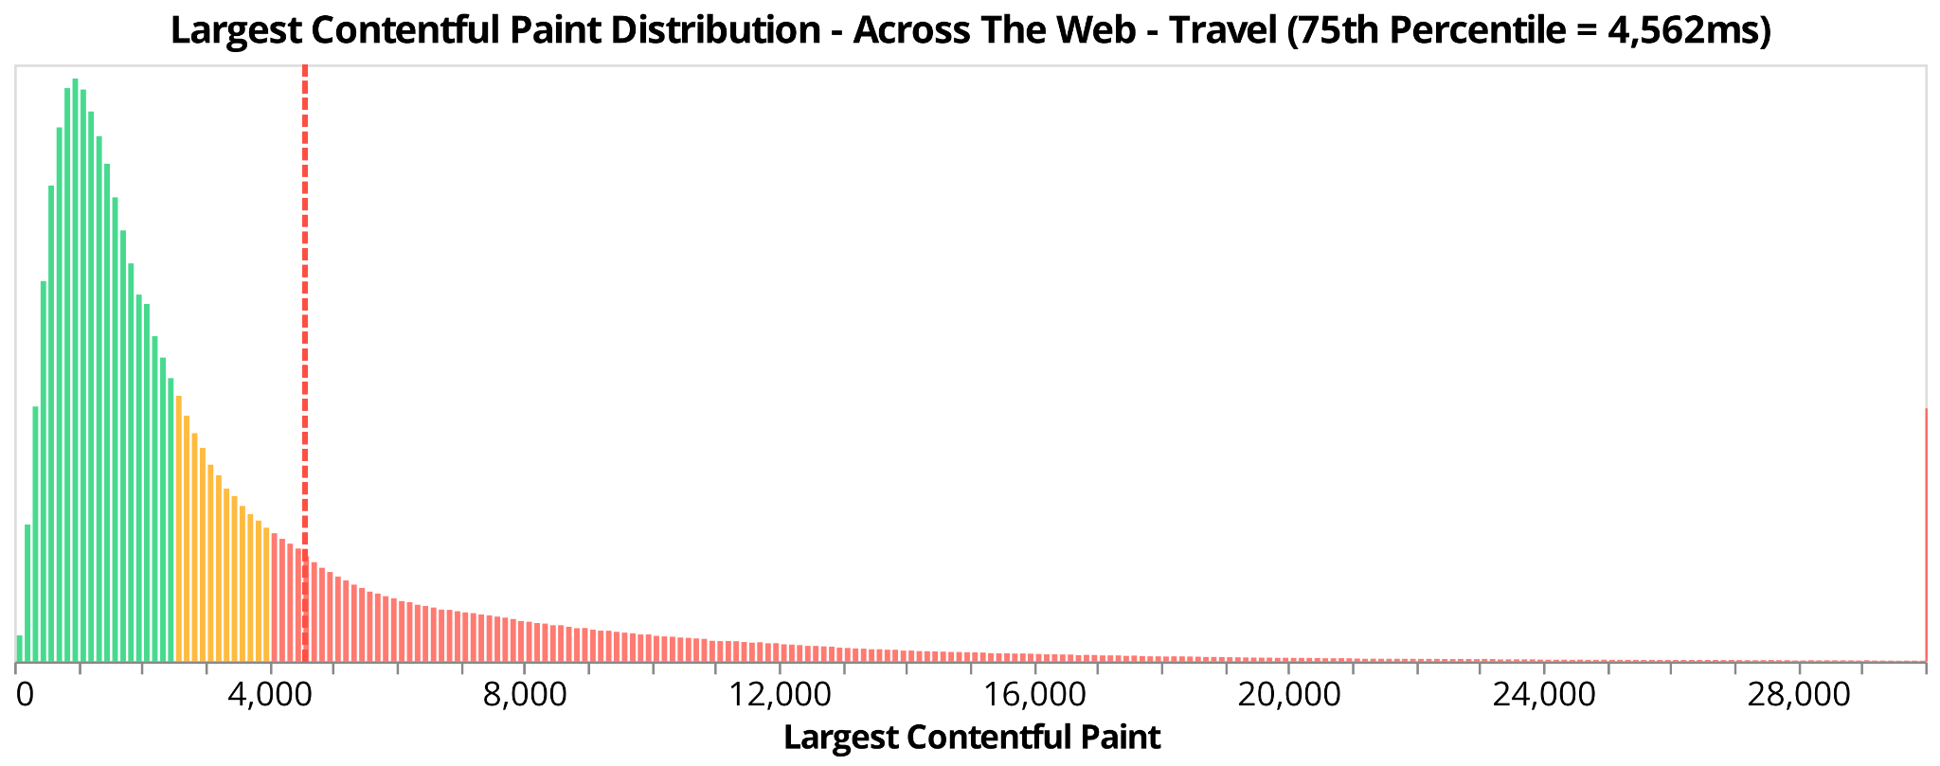
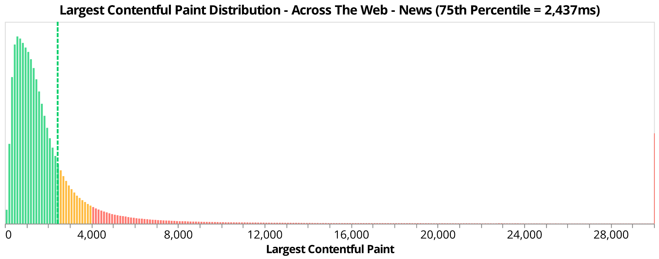

Slide 64
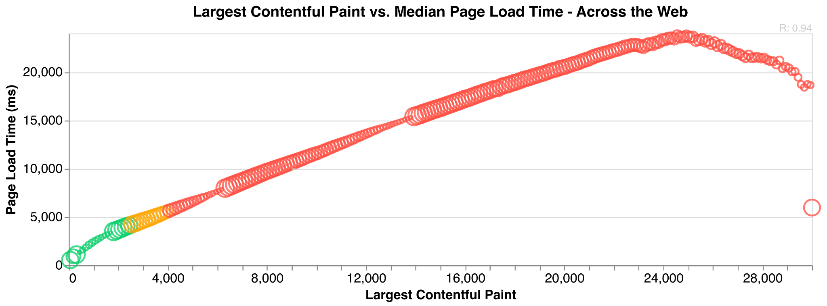

Slide 65
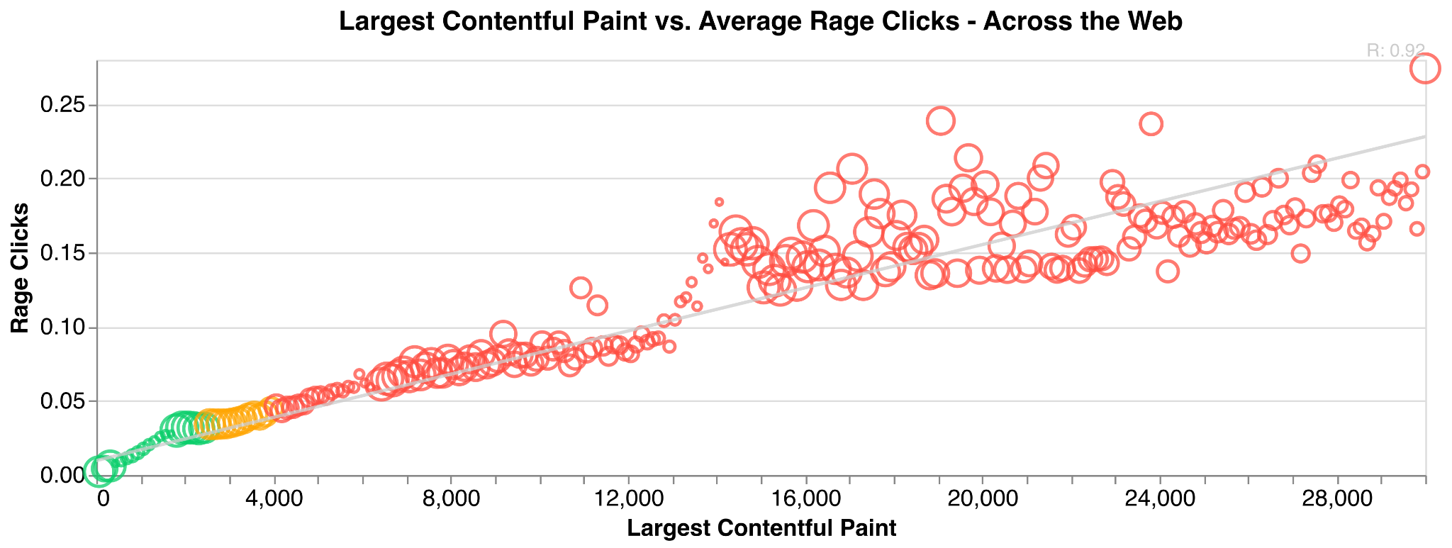

Slide 66
LCP - Data from individual websites
* unrandomly selected by Nic to make a point

Slide 67
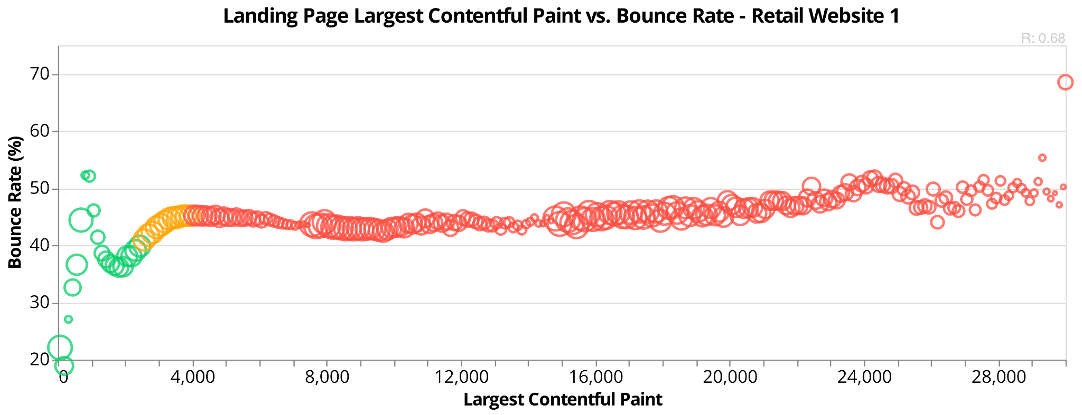
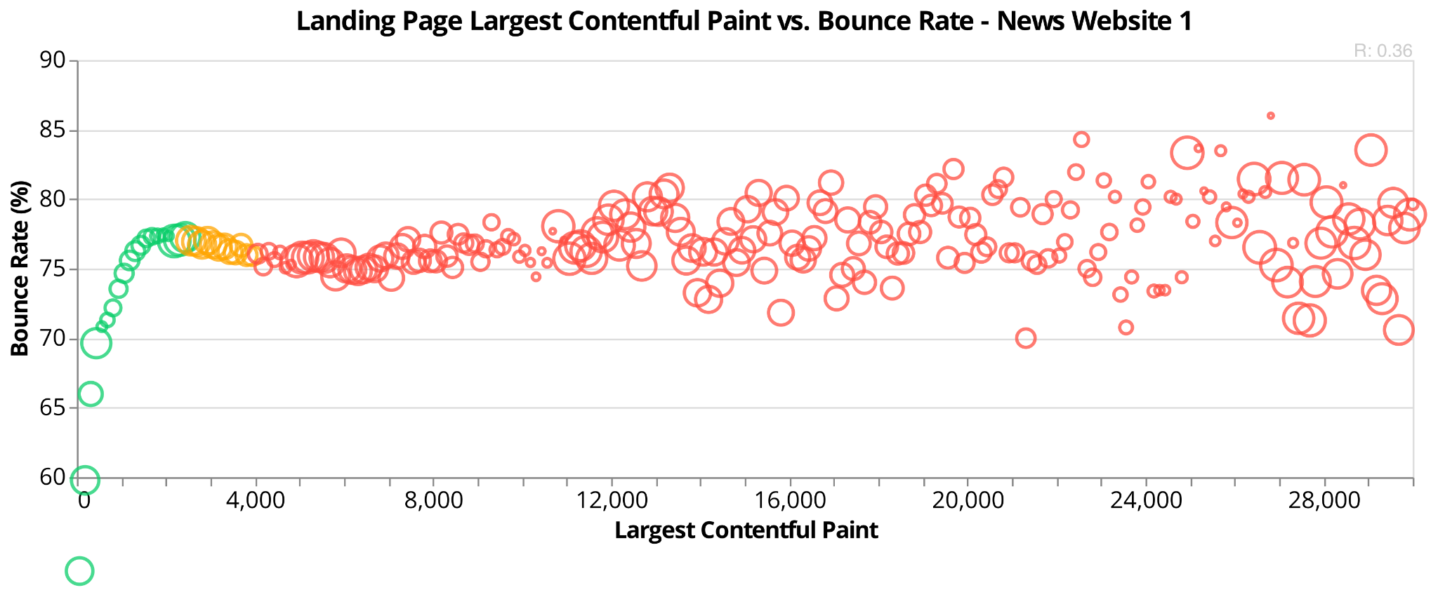
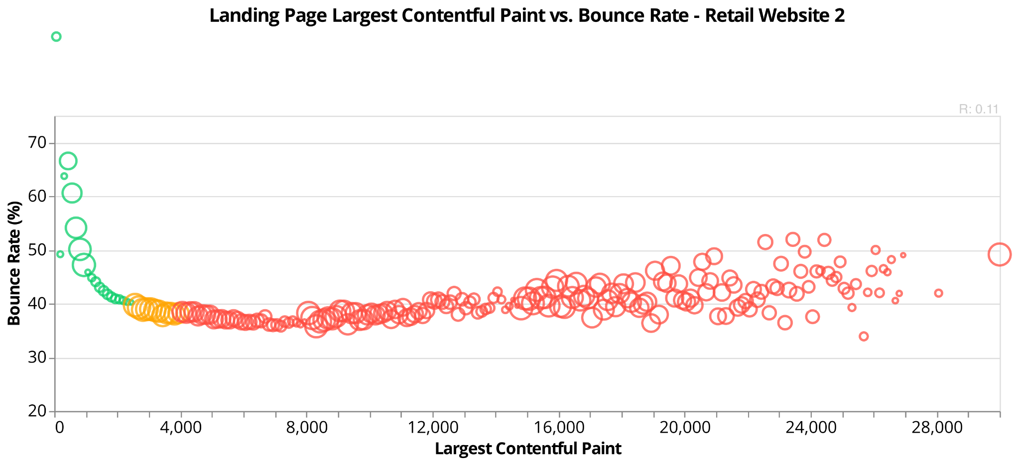

Slide 68
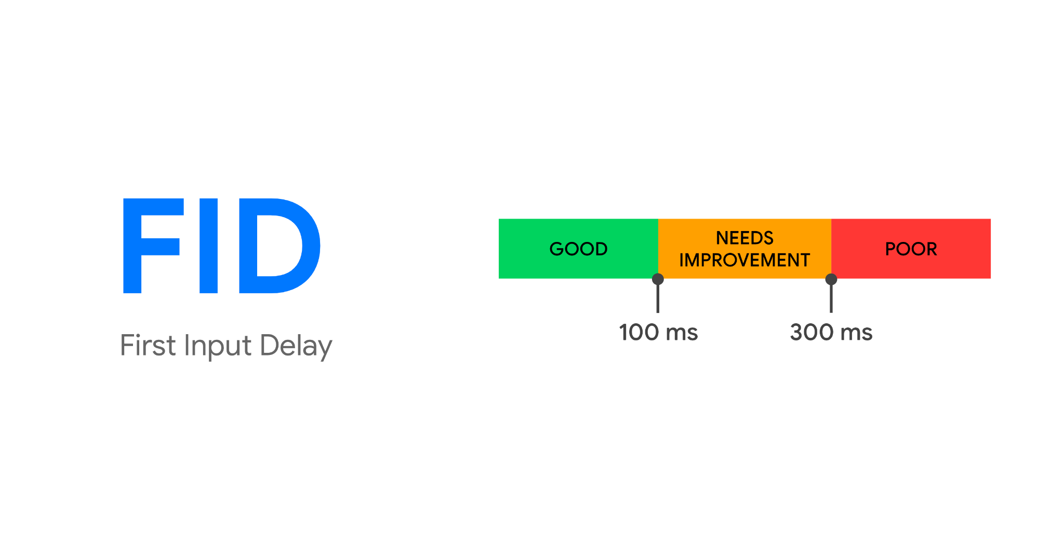

Slide 69
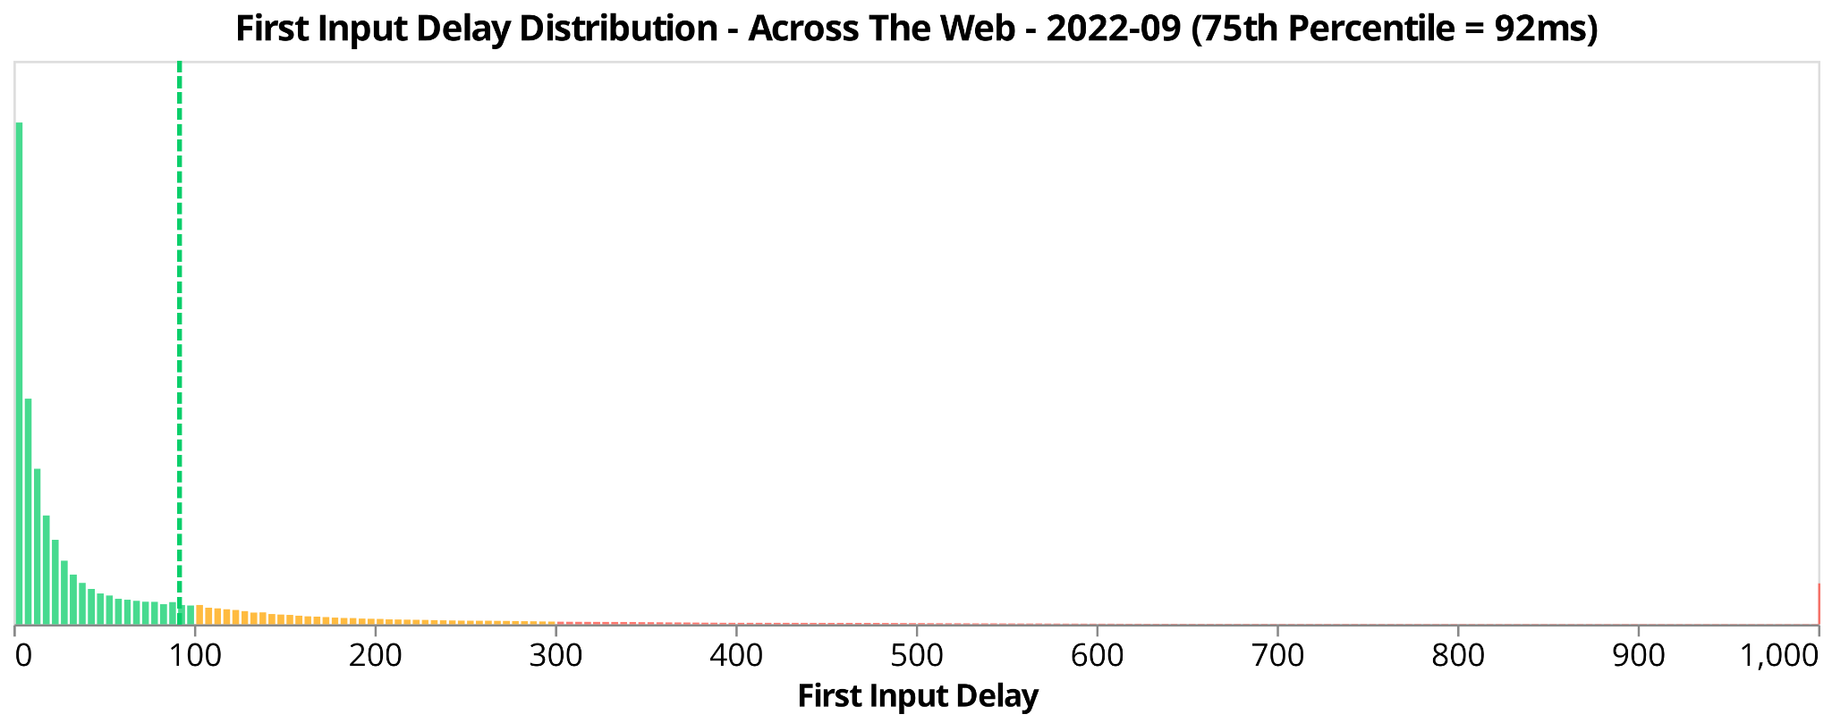

Slide 70
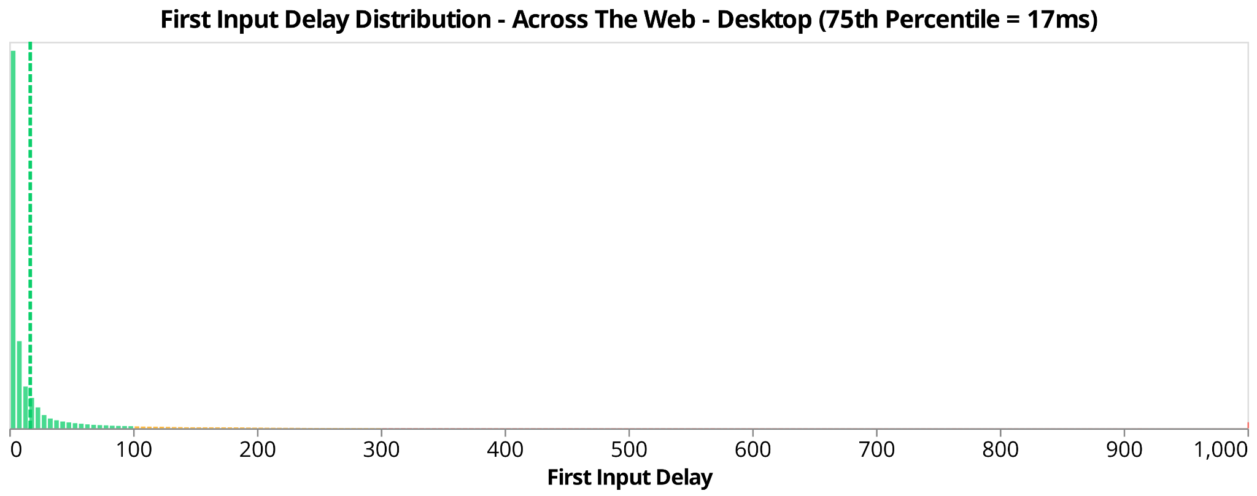
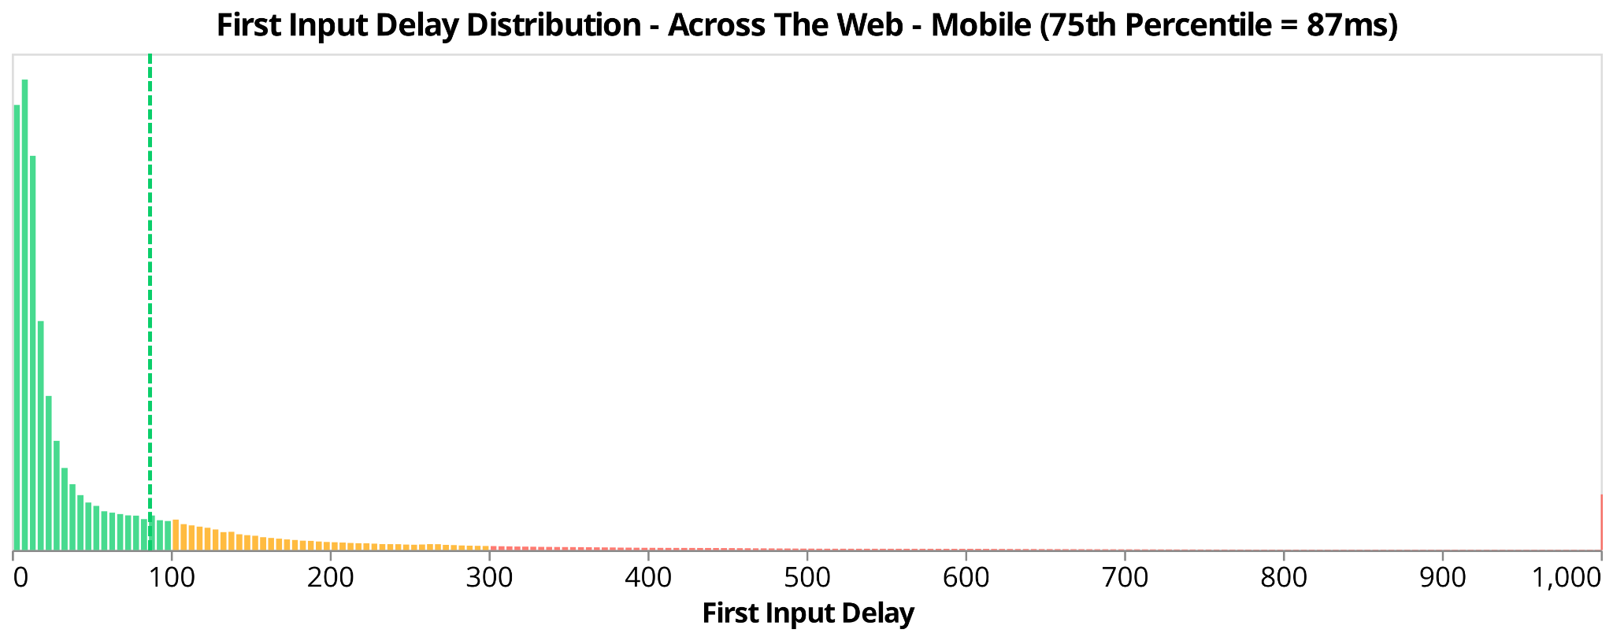

Slide 71
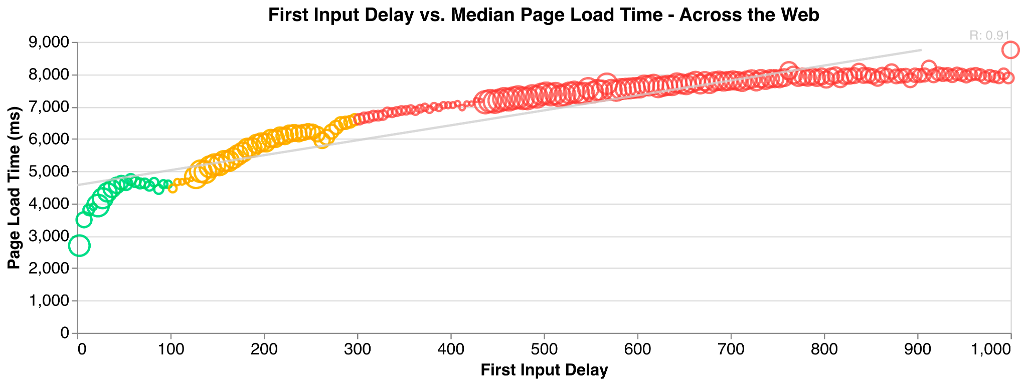

Slide 72
FID - Data from individual websites
* unrandomly selected by Nic to make a point

Slide 73
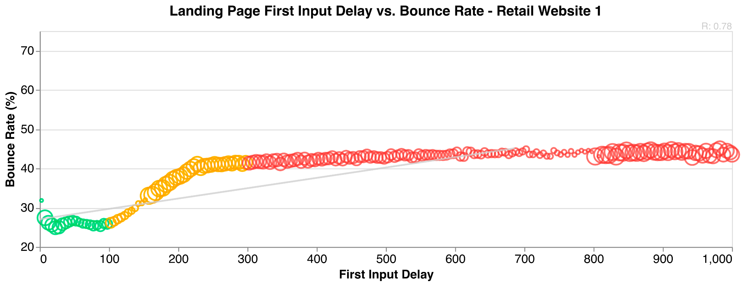
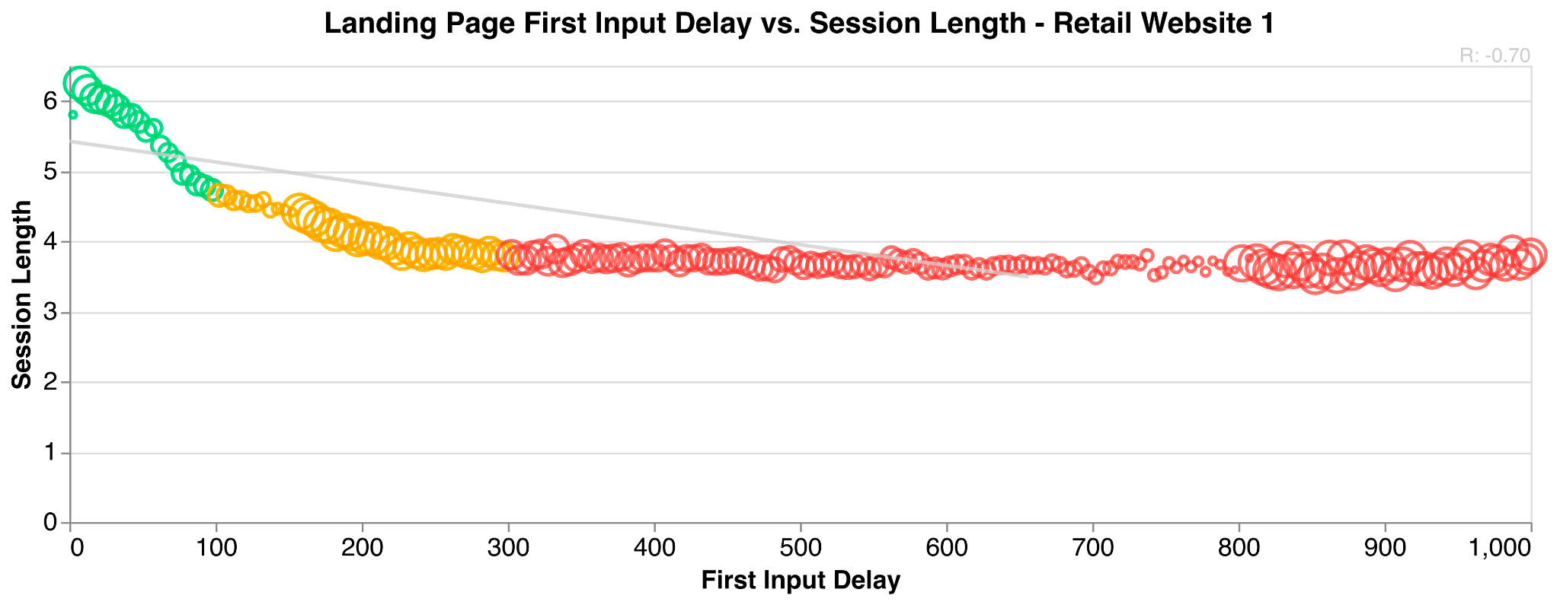

Slide 74
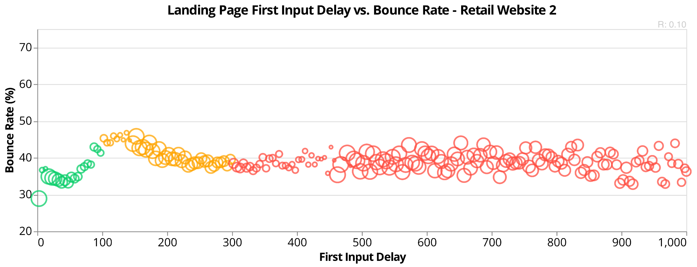
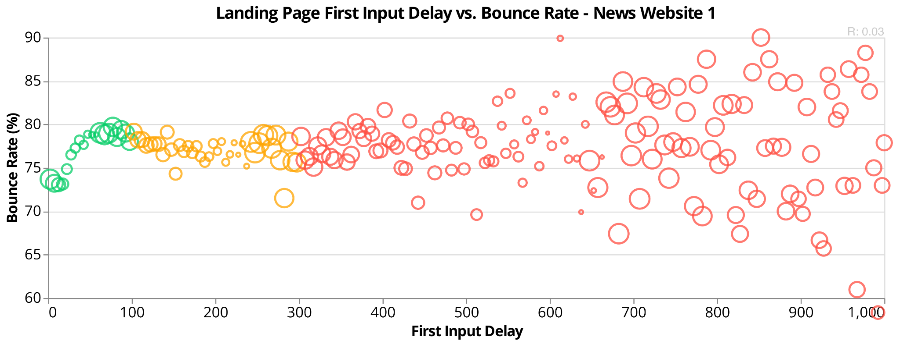

Slide 75


Slide 76
... ?

Slide 77
What CWV matters to "Retail 1"?
👍
🤷
👍

Slide 78


Slide 79
How can I evaluate a "modern" metric?

Slide 80
How can I evaluate a "modern" metric?
By yourself
RUM monitoring
Synthetic monitoring
Others
Developer evangelists
Research papers
Conferences
Public datasets

Slide 81




Slide 82
RUM Archive?

Slide 83
rumarchive.com

Slide 84
RUM Archive
Goals:
Public data set of RUM data
via Google BigQuery
We welcome others to contribute!
Individuals
Corporations
Other RUM Providers
Open-source project description, documentation and methodology

Slide 85


Slide 86


Slide 87
rumarchive.com

Slide 88
ty!
@nicj
nic@nicj.net
njansma@akamai.com

